Slide 1
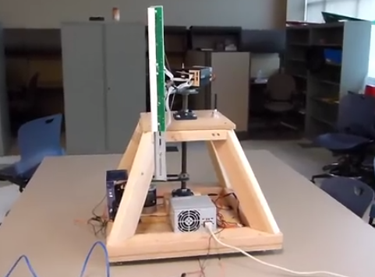
RPMs
Team Members:
Dylan Shanahan, Jordan Ziegler, Tim Decious, Josh Hemsley, Brian Ungermann, Austin Hulen

Slide 2


Initial Problem Statement
- Signal for help
- Advertise for a company

Slide 3
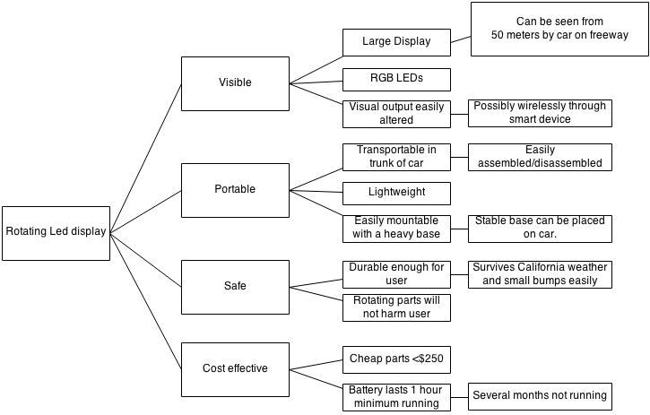
Objectives Tree

Slide 4
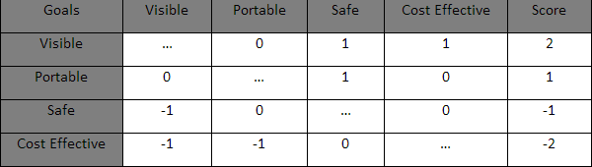
Pairwise Comparison Chart
A 1 in a box represents that the respective goal on the left is prioritized over the goal on top, 0 represents equal value, and -1 means it is less important relatively.

